Slide 1
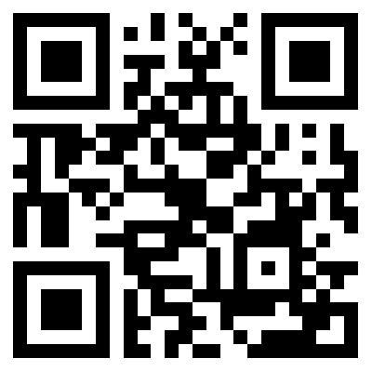
Lights, Cameras (on), Action!
Camera Usage During Zoom Classes Facilitates Student Engagement Without Increasing Fatigue.
Adam Epstein-Shuman, Kostadin Kushlev
Introduction
The number of students attending courses online has increased every year since 2002 (Seaman et al., 2018).
This trend surged during the COVID-19 pandemic; the majority of universities moved online using videoconferencing platforms like Zoom to continue virtually (Over 700 universities and colleges now use zoom, 2020).
There is a problem: 80 percent of college students find it harder to focus in newly online classes (Peper et al., 2021).
Does camera usage during online lectures affect student engagement and fatigue?
Methods
Study 1:
In a within-subjects design, we assigned students (N = 65) to have their cameras on or off for the duration of several Zoom-based classes (N_{obs} = 319). At the end of each class, students rated their levels of engagement and fatigue.
We ran a REML multilevel model to estimate the fixed effect of camera condition while also estimating the random intercept and random effect of condition.
Study 2:
At the end of an in-person class students from two Georgetown University courses (N = 81) were asked to predict how engaged and fatigued they would have felt if:
the class they just finished had been online
they had had their cameras on or off for its duration.
Viewing order of the camera usage question was randomized
We ran two mixed-level ANOVAs using engagement and fatigue as the within-subjects factor and order as the between-subjects factor.
The raw data and questionnaires used in both studies are accessible through the Open Science Framework (OSF): 10.31234/osf.io/5bz3j
Results
Study 1:
We found that students with their cameras on were more engaged (M = 3.63, SE = 0.09) than students with their cameras off (M = 3.35, SE = 0.10), F(1, 56.7) = 8.84, p = .004.
We found no significant difference in fatigue between lectures where students had their cameras on (M = 3.32, SE = 0.10) versus off (M = 3.26, SE = 0.11), F(1, 54.6) = 10.60, p < 0.05.
Study 2:
Consistent with what they experienced, students predicted that they would be more engaged when they had their cameras on (M = 3.29, SE = 0.11) versus off (M = 2.05. SE = 0.10), F(1,79) = 93.34, p < .001.
Unlike what students experienced, they predicted that they would be more fatigued with their cameras on (M = 4.03, SE = 0.11) versus off (M = 2.99, SE = 0.12), F(1,79) = 64.88, p < .001.
Discussion
This study is the first to explore the effect of camera usage on engagement and fatigue in virtual classrooms.
Our findings, however, are inconsistent with similar research:
Camera usage during work meetings increases fatigue, likely due to presentational concerns (Fauville et al., 2021; Shockley et al., 2021).
This divergence could stem from:
Increased focus on the teacher and teaching aids in large online lectures.
Fewer participants and more focus on each individual in work meetings.
Consistent with students’ expectations, camera usage increased engagement.
*
*
***
***
Contrary to students’ expectations, camera usage had no effect on fatigue.
***
References
Fauville, G., Luo, M., Queiroz, A. C. M., Bailenson, J. N., & Hancock, J. (2021). Zoom exhaustion & fatigue scale. Computers in Human Behavior Reports, 4, 100119–100145. https://doi.org/10.1016/j.chbr.2021.100119
Over 700 universities and colleges now use zoom. (2020, June 25). Zoom. https://blog.zoom.us/over-700-universities-and-colleges-now-use-zoom-video-conferencing/
Peper, E., Wilson, V., Martin, M., Rosegard, E., & Harvey, R. (2021). Avoid Zoom fatigue, be present and learn. NeuroRegulation, 8(1), 47-56. https://doi.org/10.15540/nr.8.1.47
Seaman, J. E., Allen, E., & Seaman, J. (2018). Grade increase: Tracking distance education in the United States. Babson Survey Research Group. https://www.bayviewanalytics.com/reports/gradeincrease.pdf
Shockley, K. M., Gabriel, A. S., Robertson, D., Rosen, C. C., Chawla, N., Ganster, M. L., & Ezerins, M. E. (2021). The fatiguing effects of camera use in virtual meetings: A within-person field experiment. Journal of Applied Psychology, 106(8), 1137–1155. https://doi.org/10.1037/apl0000948
Scan For More Information!
Note. *p<.05, **p< .01, ***p<.001

